Slide 1
Cmpe 250 - PS4
Algorithm Analysis
Hazar ÇAKIR

Slide 2
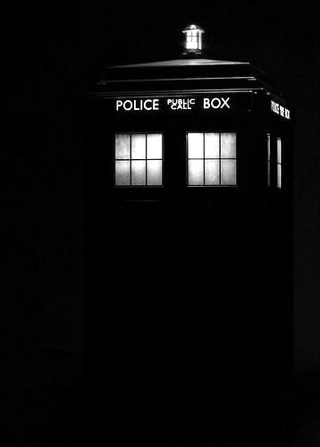
Time & Space Complexity
Space complexity
How much space is required ?
Time complexity
How much time does it take to run the algorithm ?

Slide 3
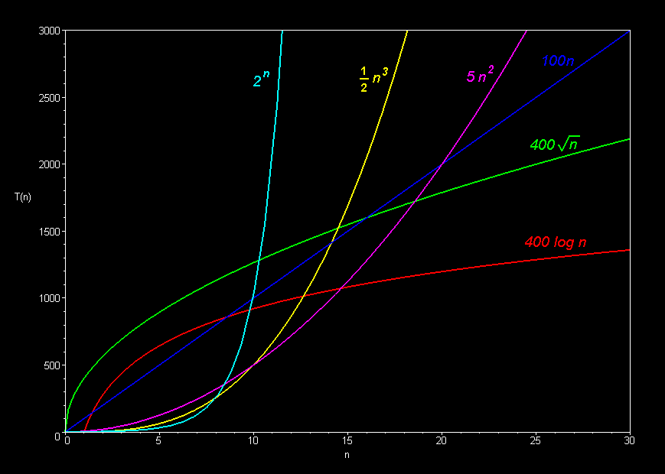
http://science.slc.edu/~jmarshall/courses/2002/spring/cs50/BigO/index.html

Slide 4
Time Complexity
"f(n) is O(g(n))" → growth rate of f(n) ≤ growth rate of g(n)
"f(n) is Ω(g(n))" → growth rate of f(n) ≥ growth rate of g(n)
"f(n) is Θ(g(n))" → growth rate of f(n) = growth rate of g(n)
"f(n) is o(g(n))" → growth rate of f(n) < growth rate of g(n)

Slide 5
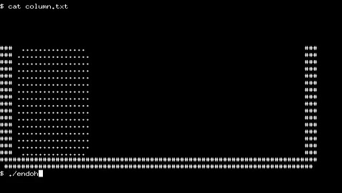
Let’s Code...

Slide 6
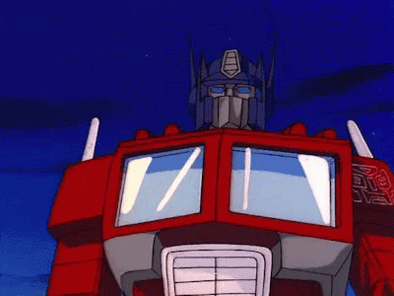
Question 1:
How to find Prime Numbers till n ?

Slide 7
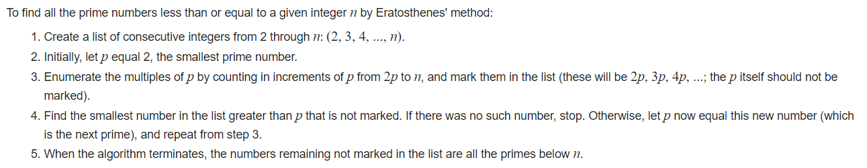
Sieve of Eratosthenes
https://youtu.be/Da8qe1TRwuo?t=3

Slide 8
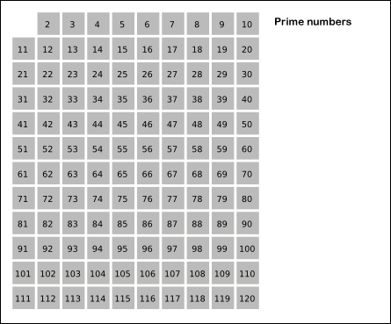
Sieve of Eratosthenes

Slide 9

Question 2:
How to calculate GCD ( ebob or obeb ) ?
https://www.ijcaonline.org/volume26/number5/pxc3874253.pdf

Slide 10
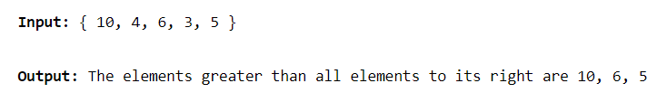
Question 3:
Find all elements in an array that are greater than all elements present to their right ?

